Slide 1
KM PROJECT
Project Title : BUY AND SELL WEBSITE Portal
01
Amrutha S
PES1201700829
02
Britney
PES1201701801
03
Riya Vijay
PES1201701814
04
Neha ND
PES1201700742

Slide 2
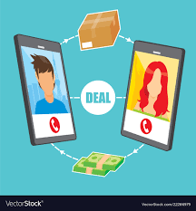
Project Abstract
The Project is a portal for Buying and Selling Portal with several KM functionalities.
Features of the portal
Login/SignUp
Admin Login
Post Advertisement
Admin Approves/Deletes
Message seller
Seller gets details of buyer

Slide 3
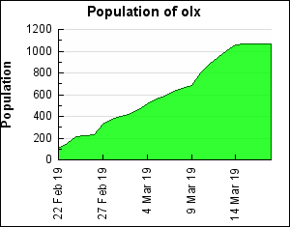
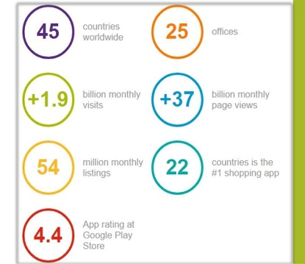
Real World Application
Need for such an application
For the seller:
Free platform to sell your old products.
Personalization and control over the sales of your product and customer.
For the buyer:
Find products at lesser price.
Personal decision authority regarding the seller after personal communication therefore preventing any chances of fraud.

Slide 4
FUNCTIONALITIES USED
KEY KM FUNCTIONALITIES
Gathering
05
Collaboration
01
04
Administration
Personalization
02
03
Categorisation

Slide 5

Gathering
Knowledge acquisition is done through forms which are filled by the customers willing to buy their products with required details.

Slide 6
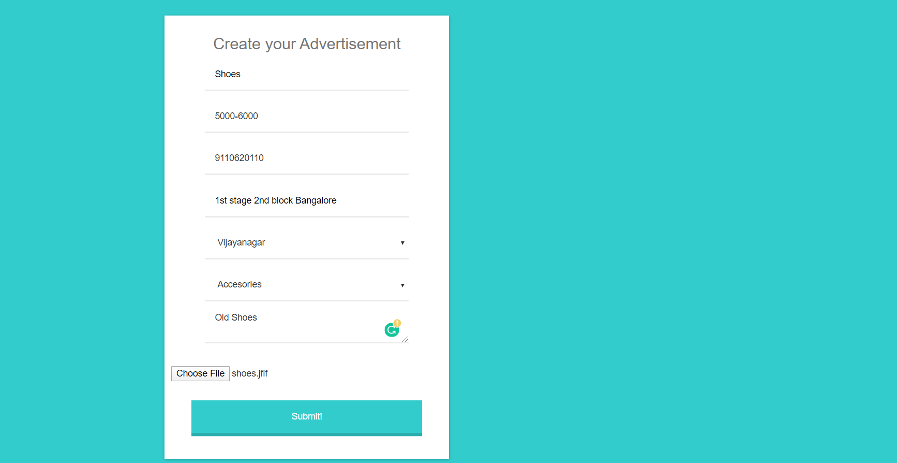
Gathering

Slide 7

Personalization
Personalisation for the customer to have interaction with the system,easy to use, aesthetically pleasing.
Personalisation we provide are :
Range of products to be sold
Range of price
Mode of Payment and delivery.

Slide 8

Categorization
Knowledge Categorization is mandatory for the ease of the buyer and we have facilitated filters such as product kind, price and area for a better customer satisfaction.

Slide 9
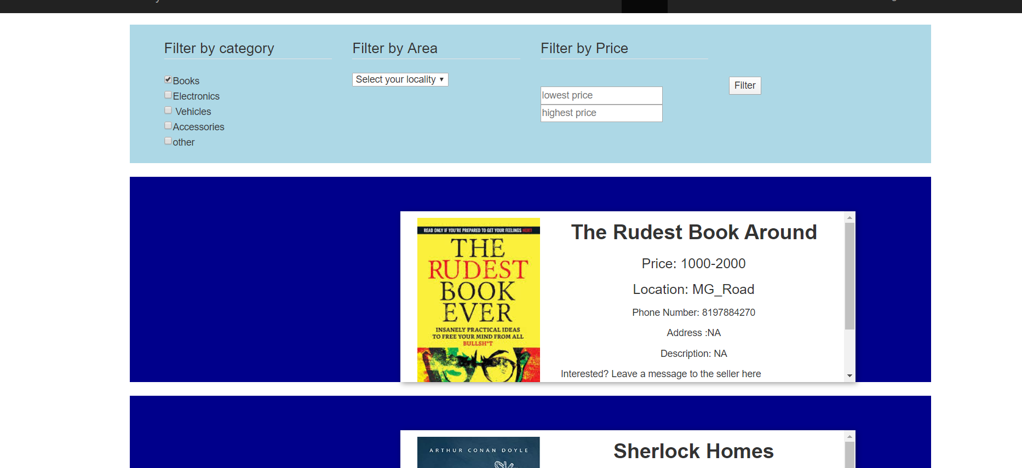
Categorization

Slide 10

Administration
Administration is important in maintaining the fidelity of the portal.We have developed a feature in which administrative authority is responsible to accept or reject the products that can to be sold.Admin can also check price statistics and take decisions based on it for approving and deleting the products,

Slide 11
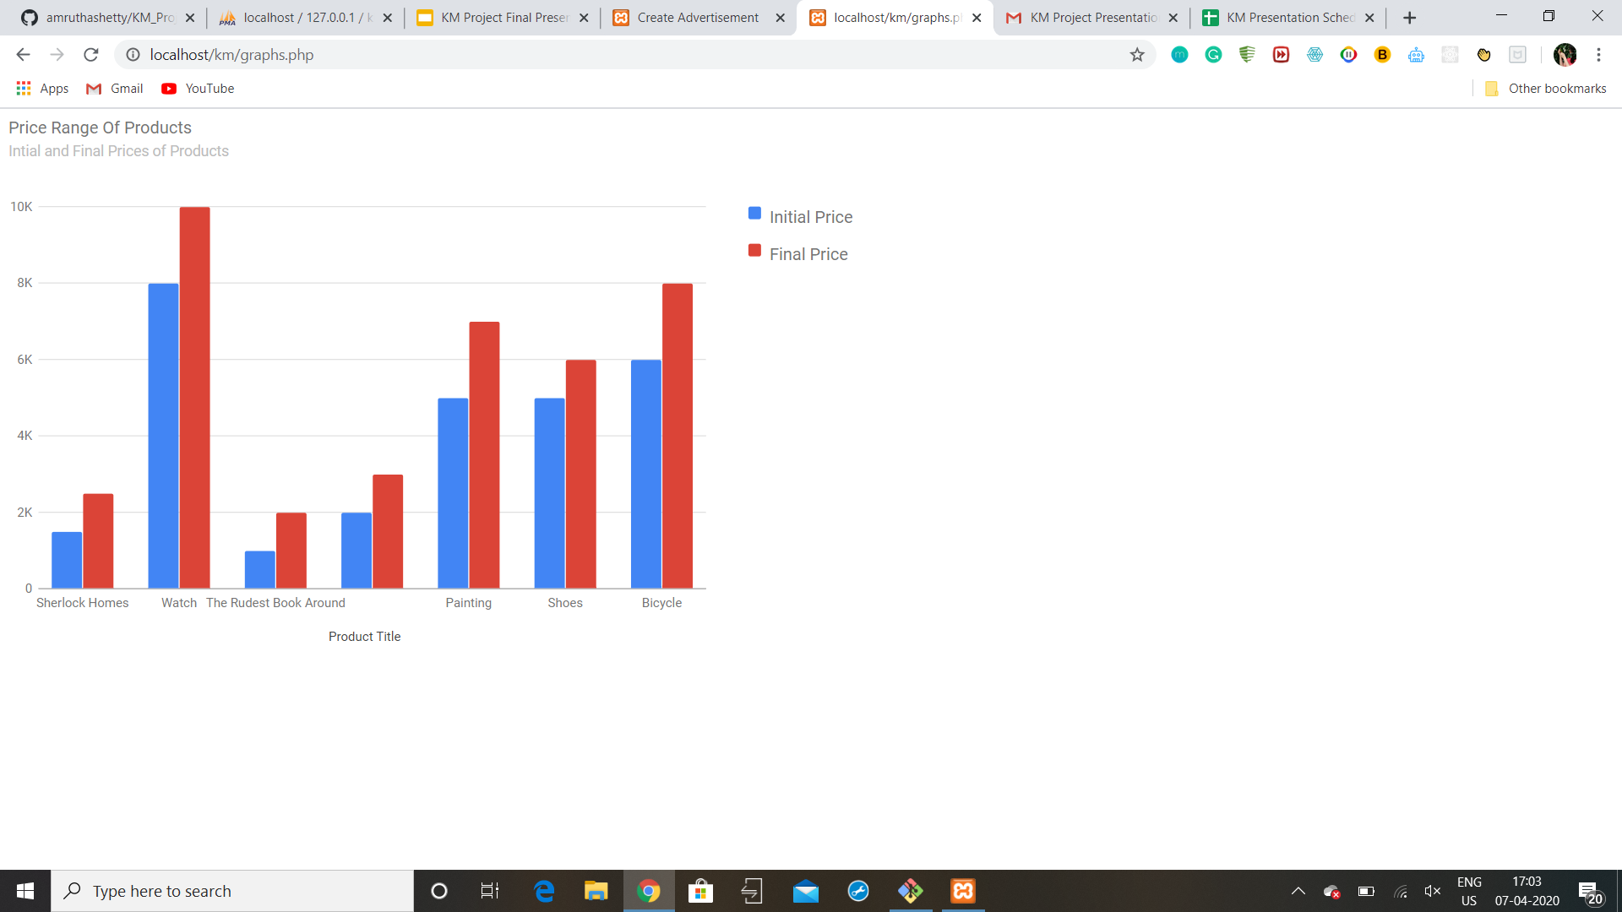
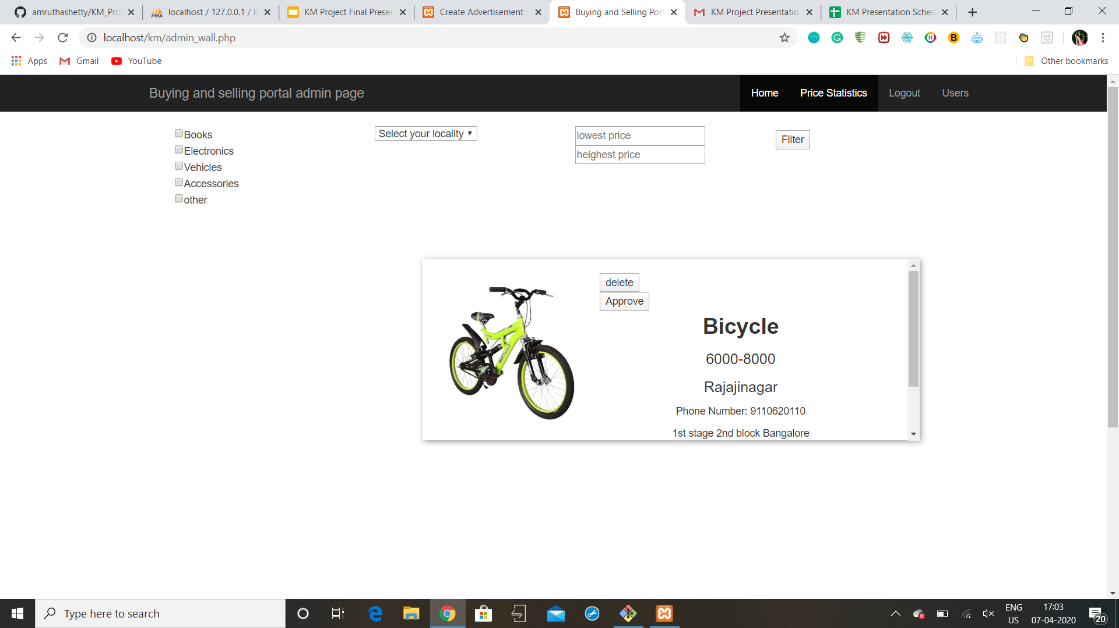
Administration

Slide 12

Collaboration
Collaboration is an important feature for a portal like ours to ensure faithful exchange between the seller and buyer,therefore we have a feature in which the buyer can ping the seller and the seller gets the authoritative hand to choose his seller respectively.

Slide 13
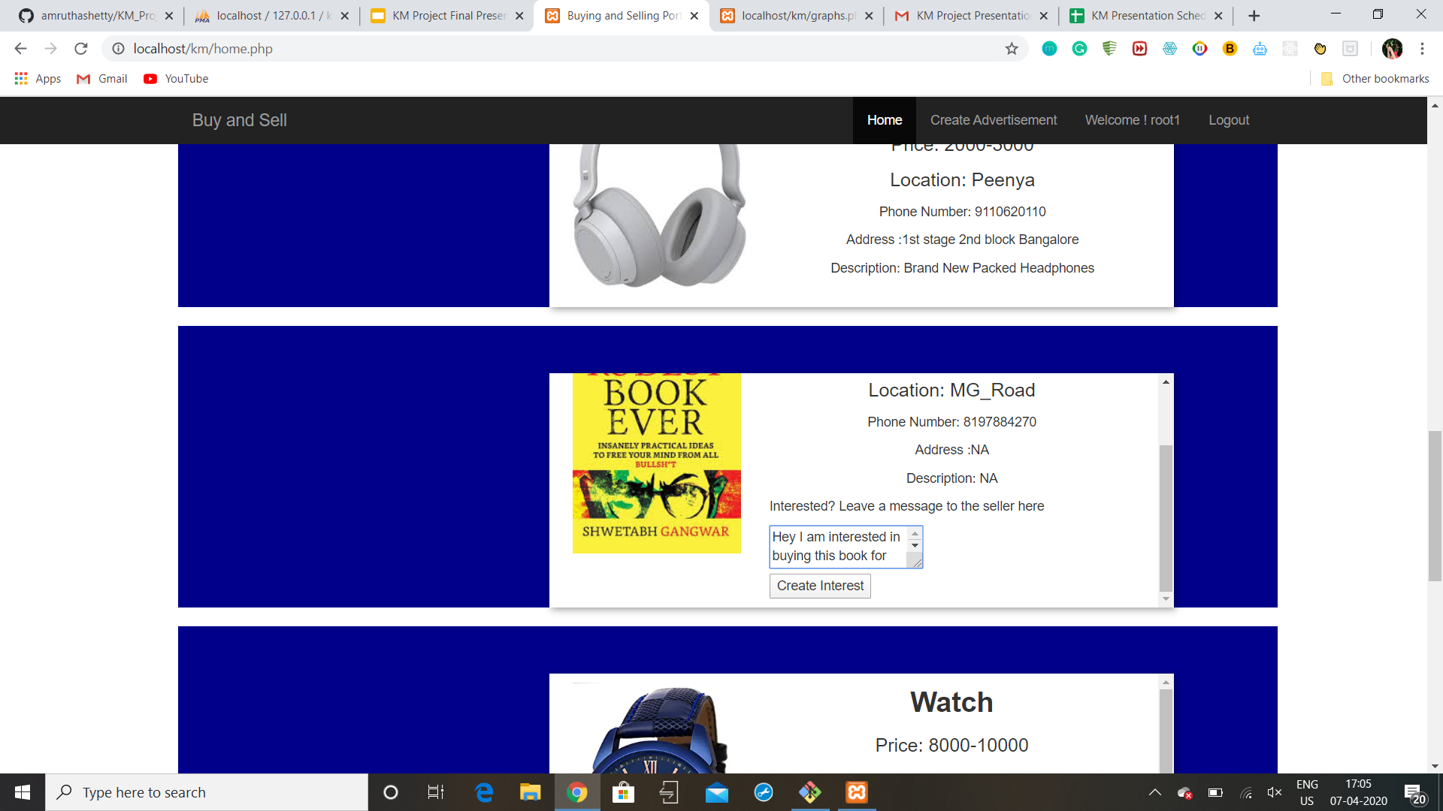
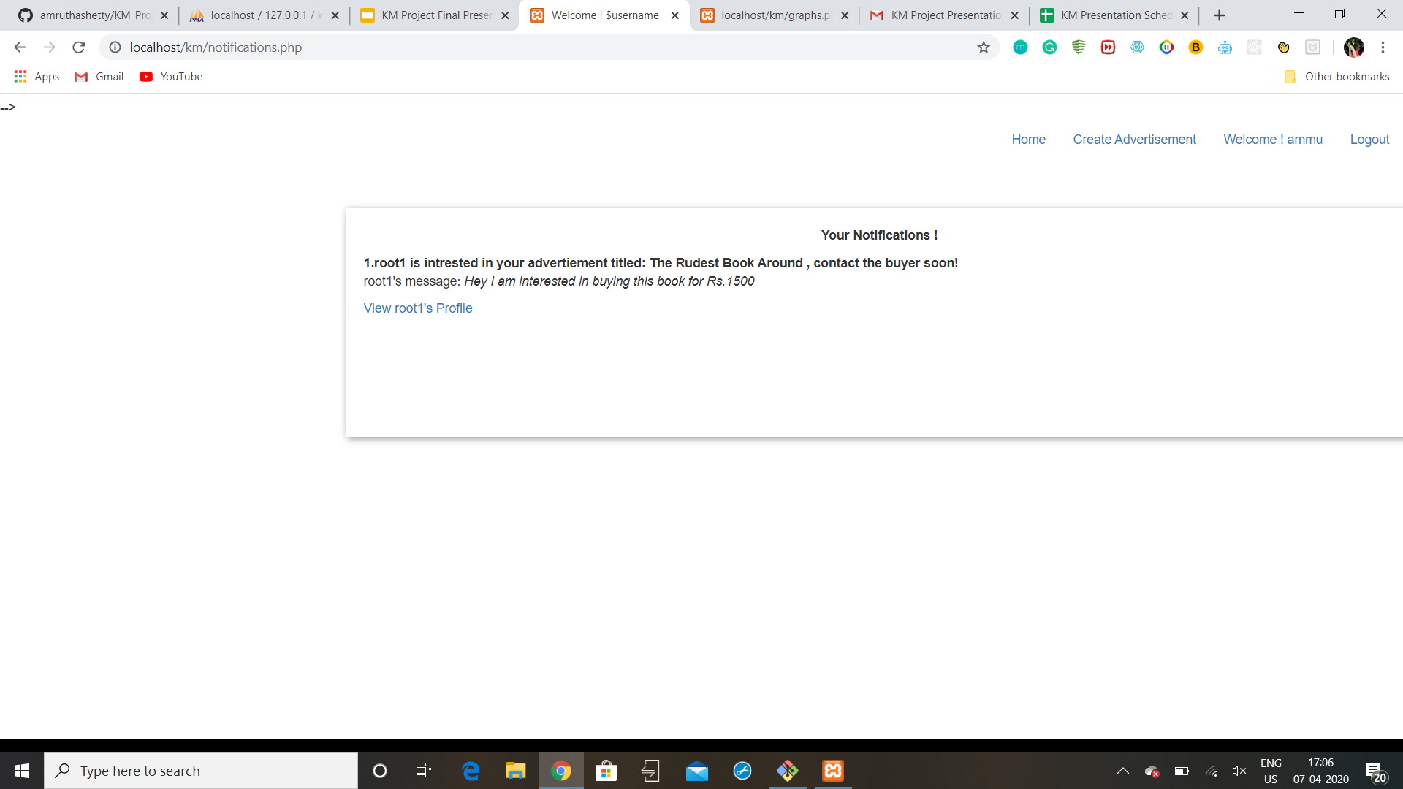
Collaboration

Slide 14
FUNCTIONALITIES USED
Technologies used
HTML
CSS
JS
PHP

Slide 15
THANK YOU

